Slide 1
Extract, transform, and load [ project 1.5 | v2.0 ]
Elie hakim
Miguel patxot
------- ------- -------
November 7, 2019

Slide 2

Objective:
We’re looking to observe the trends of fuel-ups on vehicles based on fuel ups from Fuelly community online. With a given sample we’re going to dive into important questions:
What are Average Fill Ups looking like?
What Type of Vehicles are Consumers actively driving?
Are gas prices driving what type of cars we tend to be driving?
Do we believe people are more concerned with bigger cars? Smaller cars?

Slide 3
Data sources:
Fuelly
http://www.fuelly.com/car
http://www.fuelly.com/activity?filter=4
AAA Gas Prices
https://gasprices.aaa.com/
Kaggle – Fuel Capacity – Future usage
https://www.kaggle.com/gagandeep16/car-sales

Slide 4
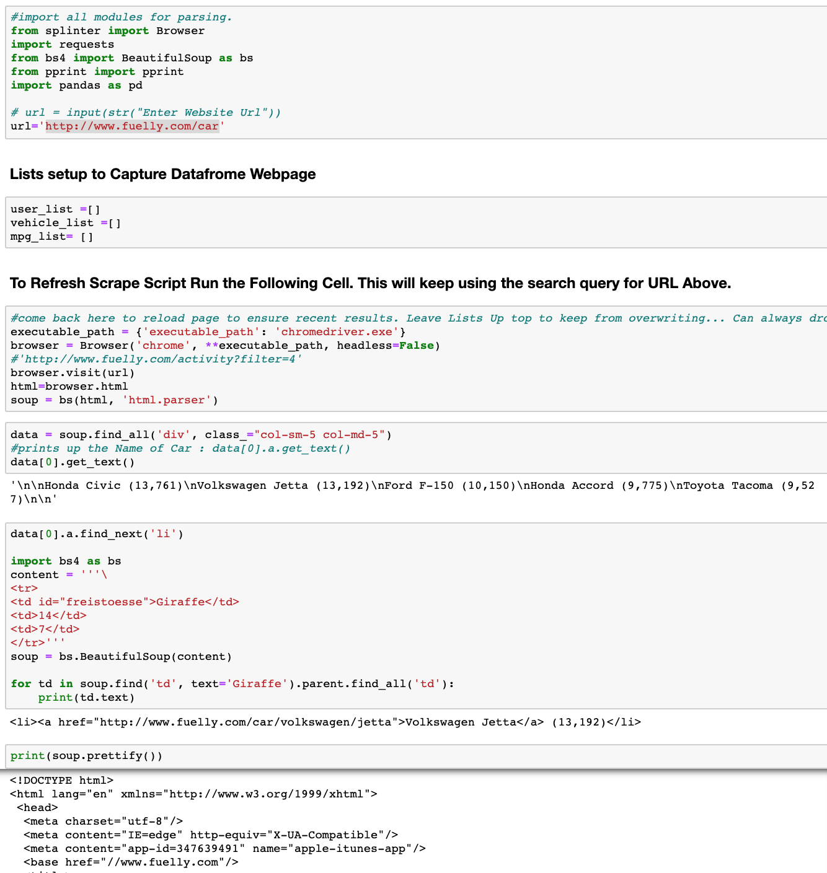
Extract:
Our objective is to Web-Scrape “Active Fuel-Up” Data from the Fuelly website with regards to drivers in the United States.
First, we identified the type of data to capture from the active fuelly fuel up log.
WE needed To build a substantial dataset we scraped every half hour to hour.
Identified elements to capture in respective lists to finally transform our captures into a dataframe.

Slide 5
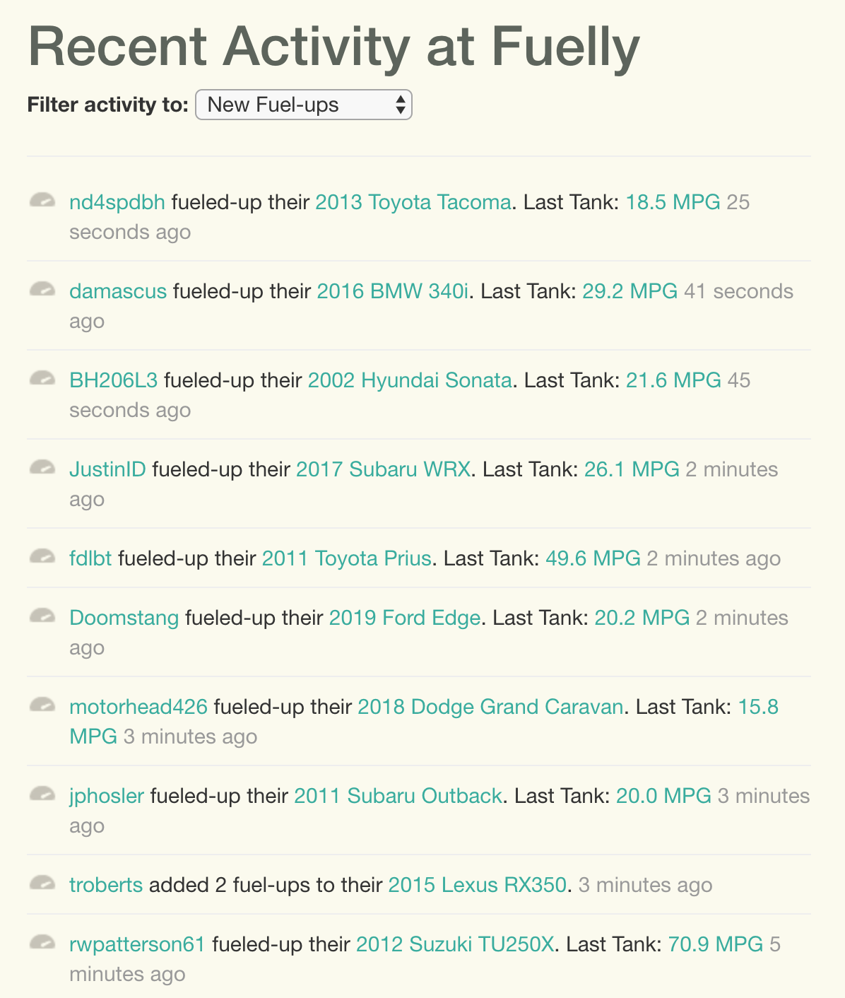
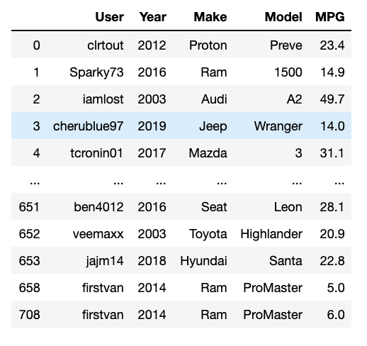
Transform: Fuelly

Slide 6
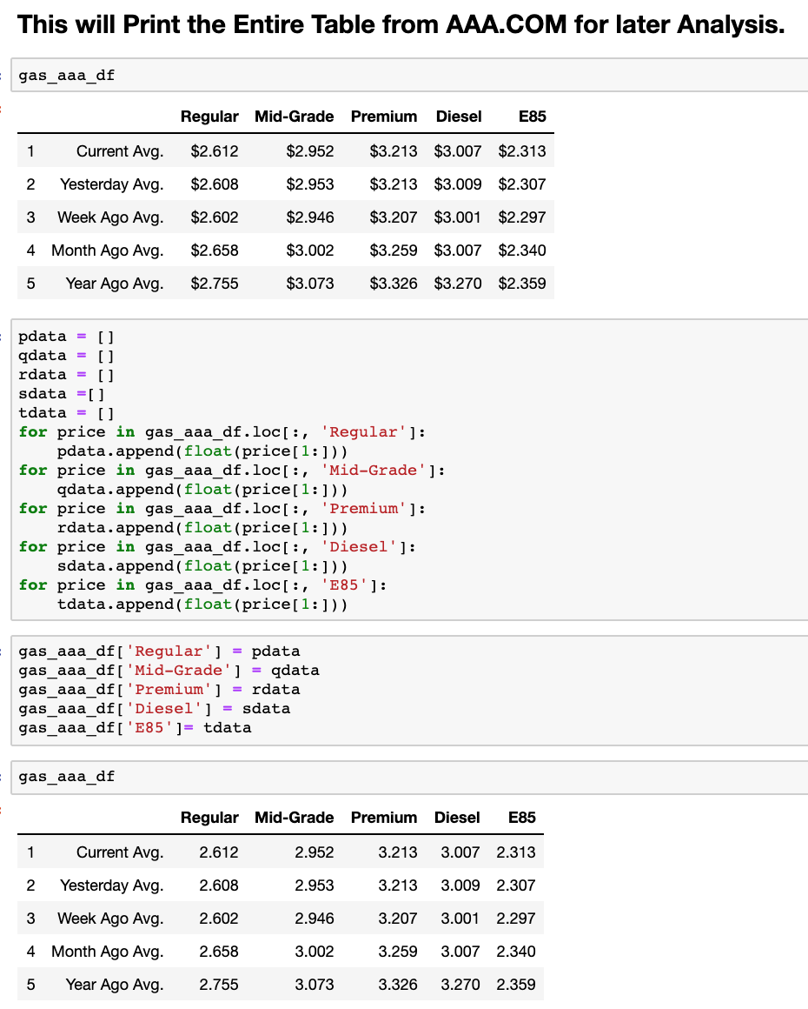
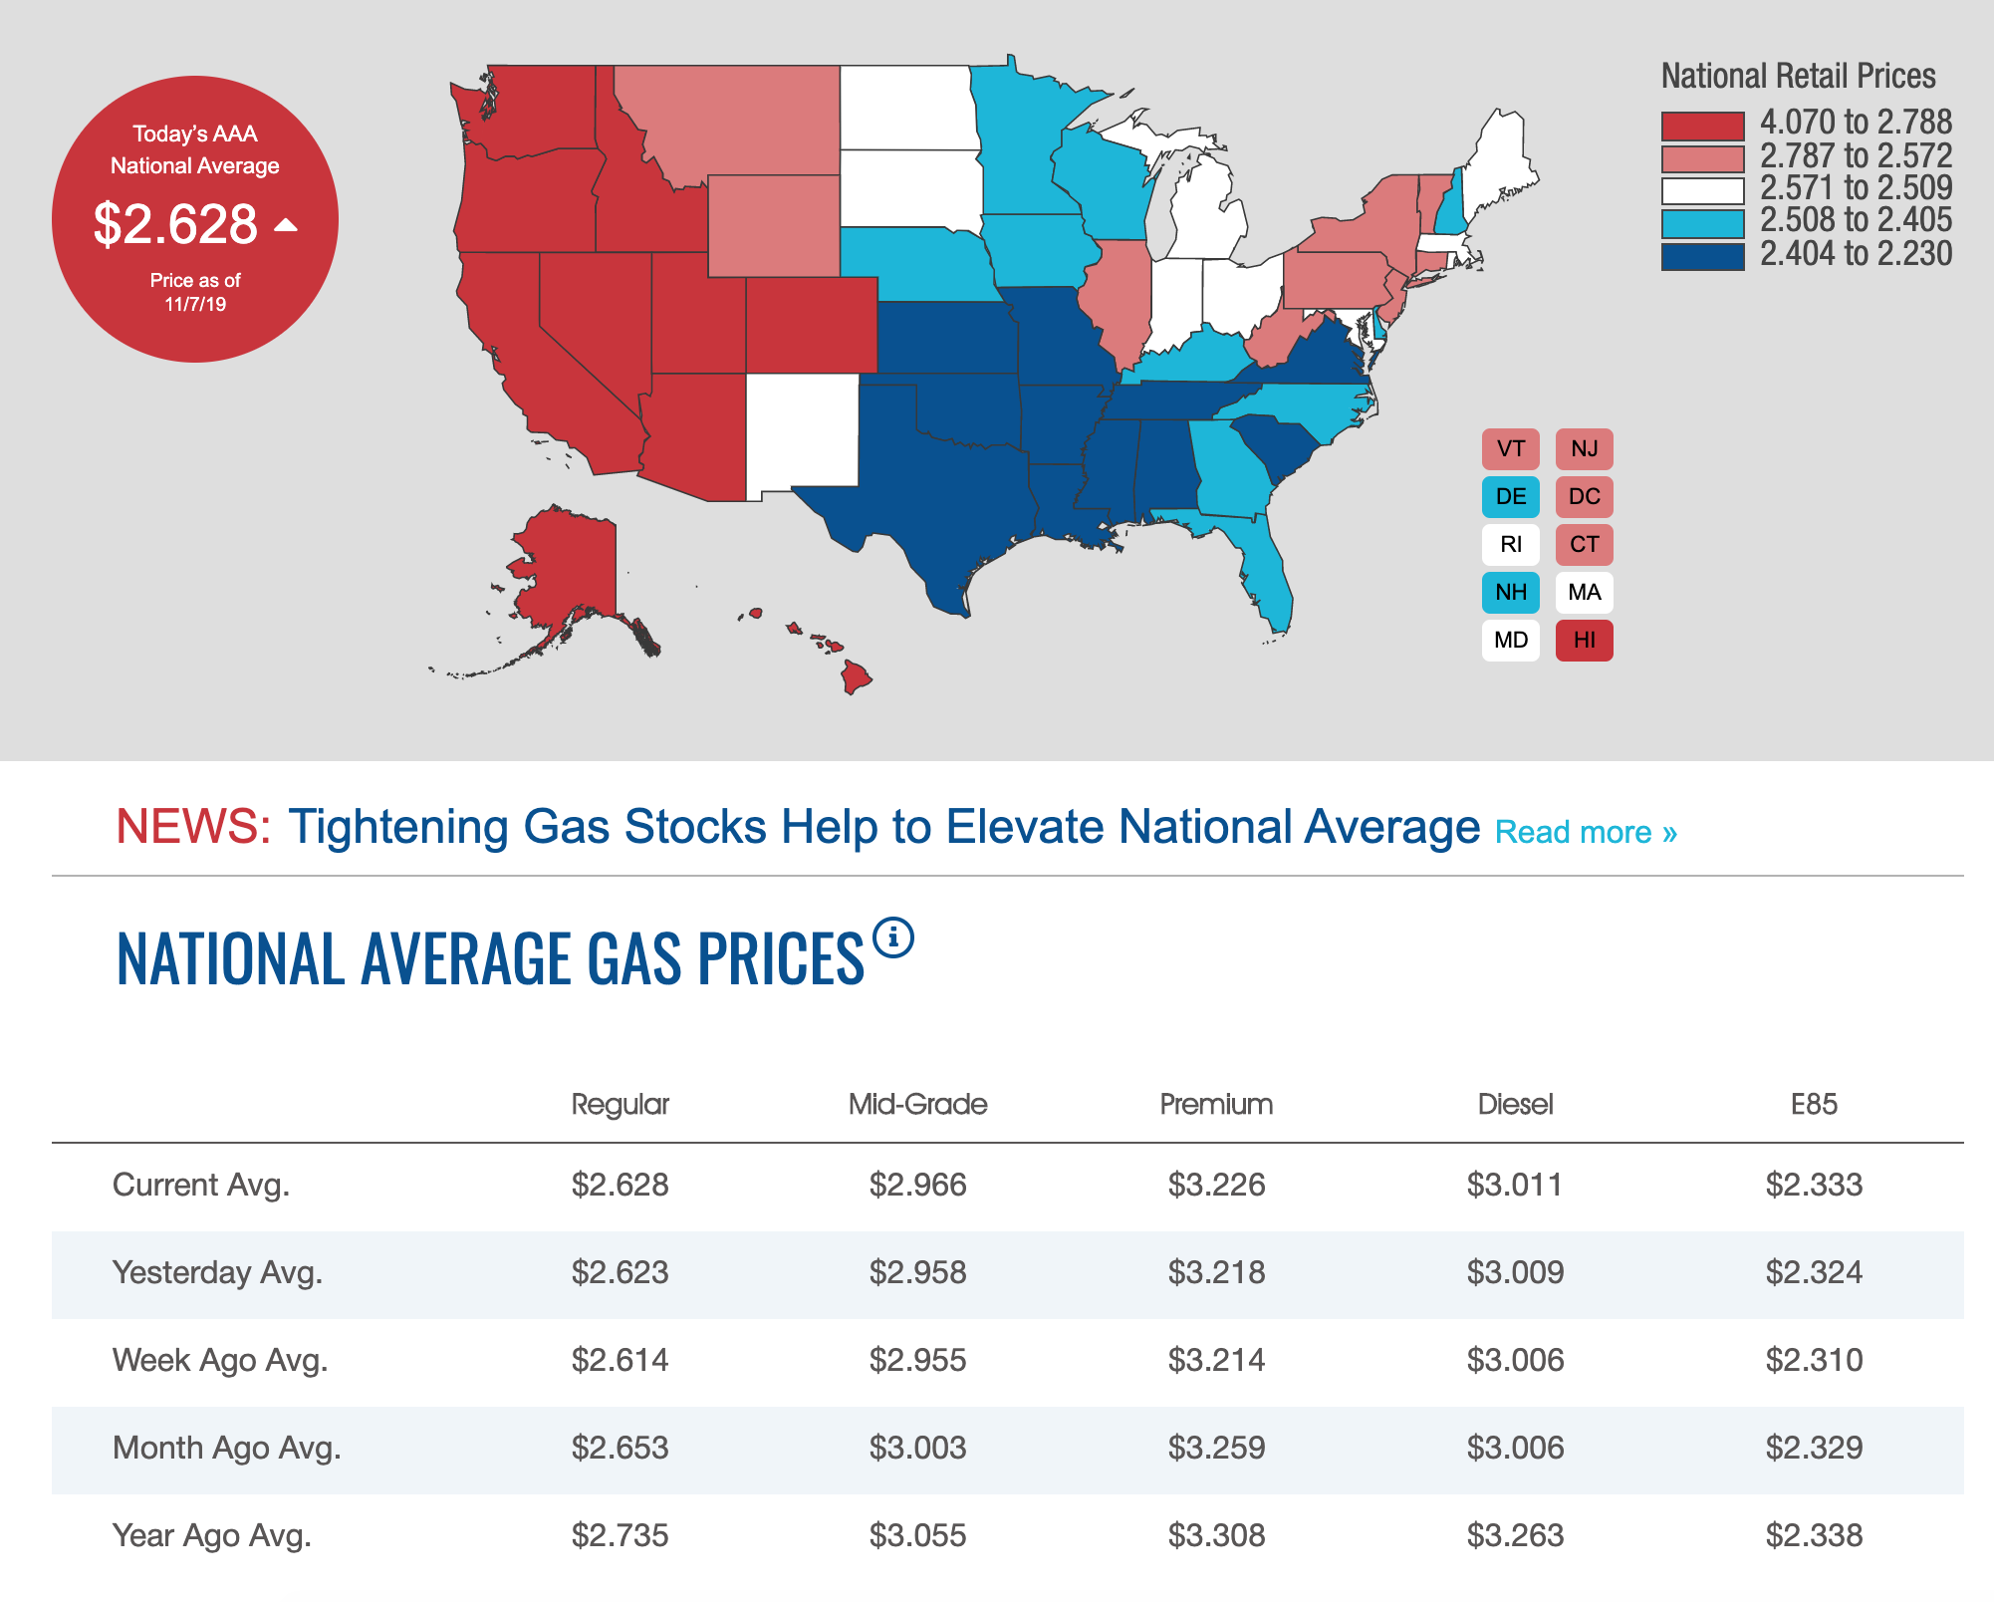
Transform: AAA

Slide 7
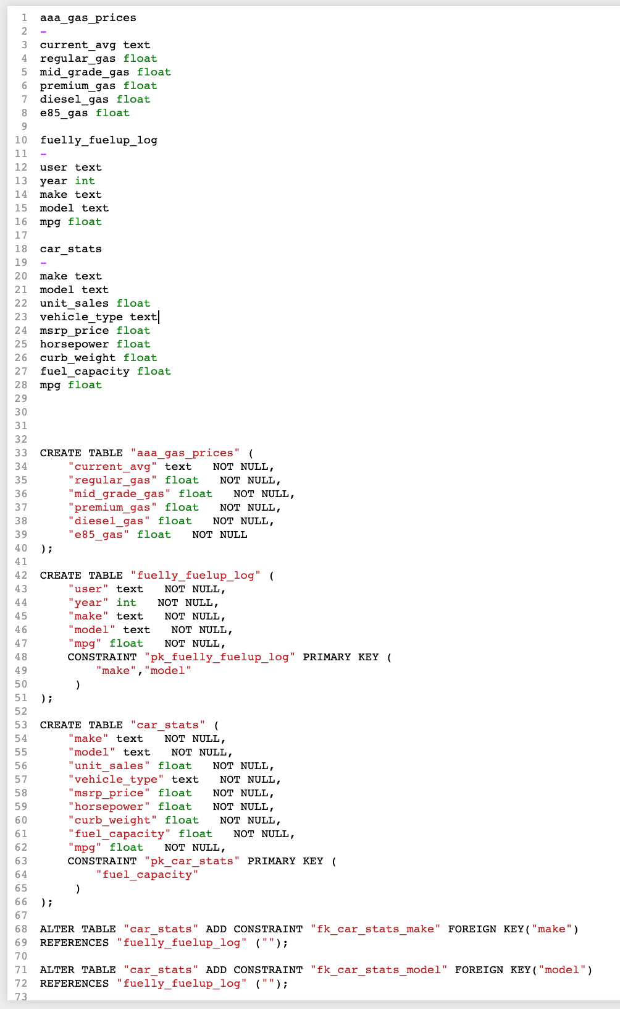
Load: to postgresql

